Slide 1
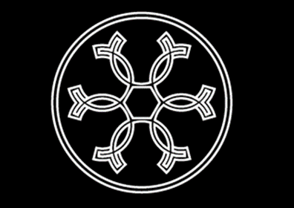
Cover

Slide 2
OUR
STORY
Ceramication is a Singapore-based boutique porcelain maker founded on 9 August 2020. From the moulds to forms, clay bodies to glazes and processes, everything is laboriously designed by the founder. Handcrafted in Singapore using only the finest minerals sourced from around the world, every individual piece has passed through the hands of the artist numerous times, thus boasting the signature of handmade studio ceramics.

Slide 3
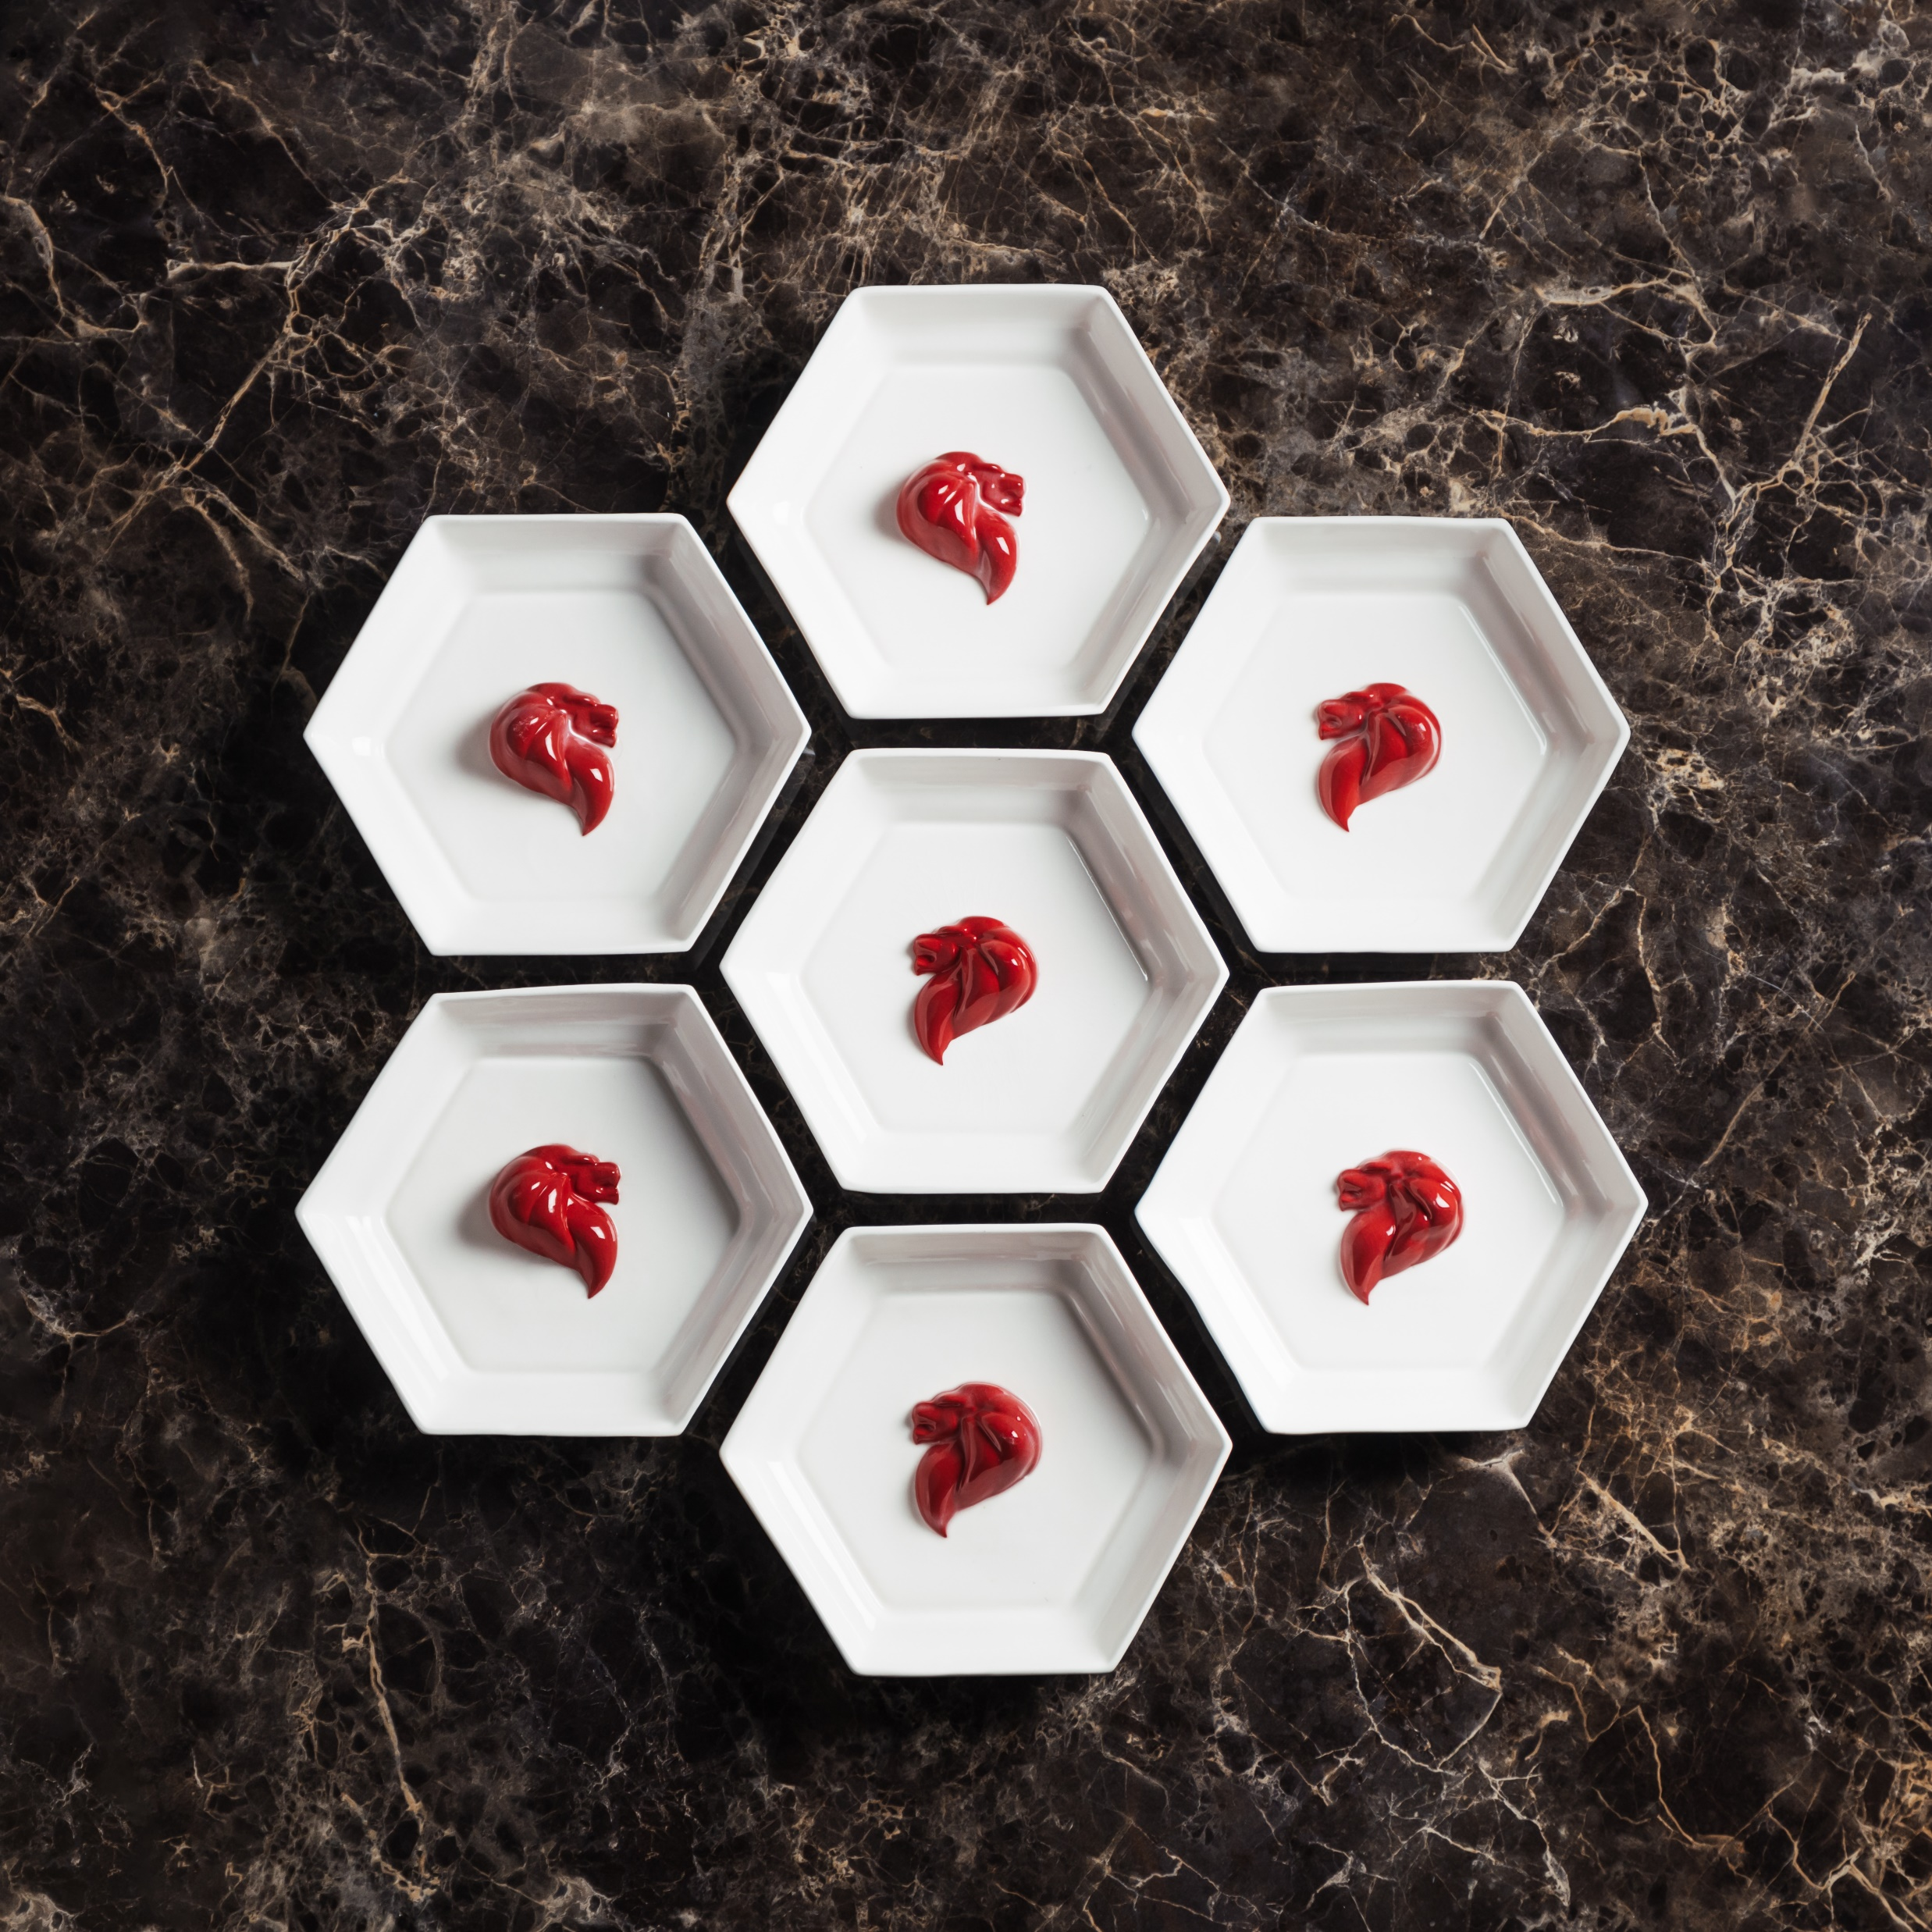
Design Philosophy
The Symbolism of Hexagon
Food is the language of love. Sharing a meal together is how generations of Singaporeans convey their love to the people most precious to them. One day, while enjoying dinner with his family, Ceramication founder Rayn Leow noticed that his nephew was dropping morsels of food all over the table. This evoked a whimsical idea of hexagonal tableware.
The more thought he gave to it, the more the idea had merit. Hexagons form a perfect network with zero distance between unique individuals, leaving no wasted space. Because of its structural stability, it is a recurring geometry abounding in both science and nature, from the configuration of atoms in the molecular structure of clay particles to cells in a honeycomb.
Hexagon thus became the governing design philosophy of his pottery company, Ceramication. It symbolises love between partners, families and communities. It is about inclusivity — one can be of a different colour and still fit in a network perfectly. Yet it also celebrates liberation: an individual should have the right to be who he or she is.
As a pottery maker in Singapore, Ceramication seeks to create beautiful yet functional tableware and décor pieces that serve as a medium with which Singaporeans can express their gratitude, devotion and love to one another. Every Ceramication piece is handcrafted, a hallmark of thoughtful design.

Slide 4
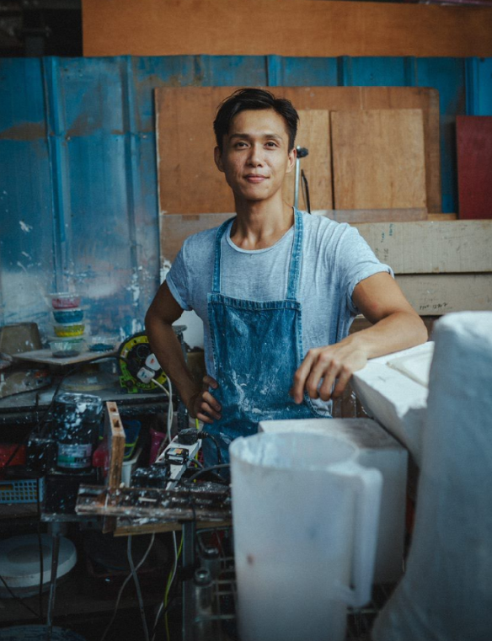
Our Artist at the helm
“The oldest pottery excavated to date is 20,000 years old. This linkage to our ancient ancestors, likewise, connects the fate of our future generation to our current actions or inactions. Every single thing that we do today will eventually distil into our culture – the way we think, our work ethics, our expectations and interactions. We must do our very best.”

Slide 5
Since he was a child, Rayn Leow has always shown an affinity for the arts. One of his fondest memories is playing with mud, which he dexterously sculpted into figurines. In secondary school, he joined the symphonic band, revelling in his role as a French horn player.
Despite his artistic leanings, at the fork of the road, Rayn pursued the science track and studied evolutionary biology in university. The work was humdrum. Wanting to be self-reliant when he returned, he became a combat engineer officer in the Singapore Armed Forces. Pottery, being a confluence of skills, sculpting and sensuality, was the autodidact’s creative outlet. Following his three-year army stint, he worked as a manager at his father’s construction business. Unbeknownst to him at the time, the Computer Aided Design (CAD) software knowledge he picked up while creating and amending construction drawings would later benefit him as a potter.
While he suppressed his true passion to continue earning a livelihood, it never faded. It took a tragedy of losing a very close friend to cancer to jolt him out of his rut. With a resolve not to waste his life anymore, in 2020, he carved his own path to set up Ceramication. His interwoven experiences give him a unique advantage. The scientist in him is at ease with mixing materials in their elemental forms. His CAD knowledge allows him to render intangible concepts into 3D perspectives of visible lines, shapes and shades.
Today, at Ceramication, even as he pays homage to the past, Rayn sets on defying conventions with his art.

Slide 6
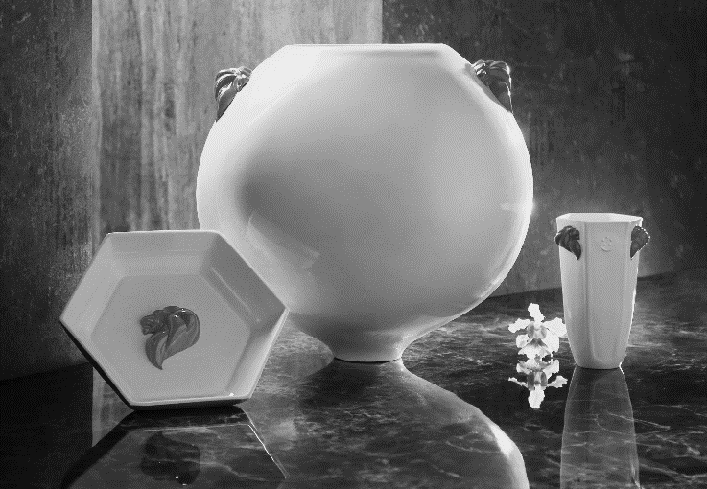
Mission
The record-keeping tradition of ceramics has played a vital role in helping us understand humanity throughout the ages. We aim to build upon Singapore’s cultural history by creating ceramics that will inspire Singaporeans for generations to come.
Values
Safety is the most basic form of human rights
Diversity is the engine of evolution
What nature gave, humans must nurture
Utilise technology to unlock human potential
Produce designs that pay homage to the past
Combine technology and design to achieve quality that will stay relevant in the future
Vision
We envision a world surrounded by beauty and harmony, where all individuals are respected for who we are and how we choose to live our best lives. Every object is a work of art, useful and meaningful.

Slide 7
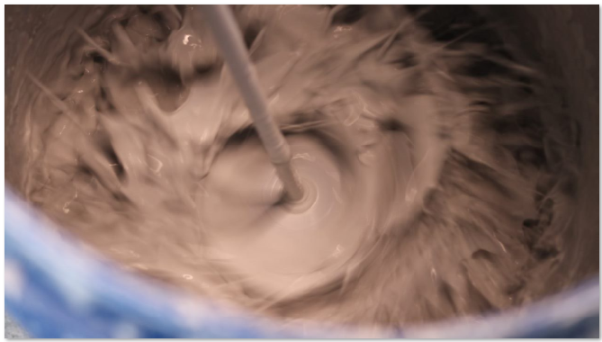
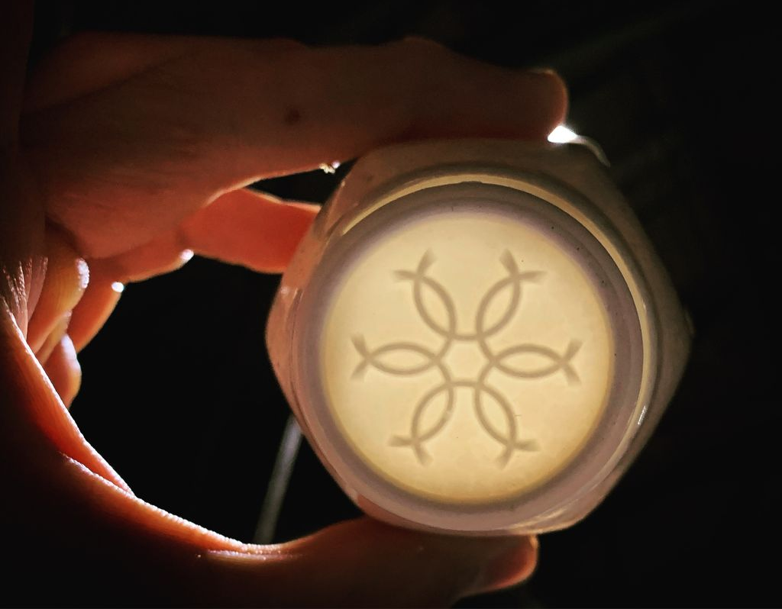
Our Materials
Rayn approaches pottery making with a highly methodical mind. To make each Ceramication piece, he uses premium-grade materials sourced from all over the world. The materials are mixed to form liquified clay called slip.
‘Safety is the most basic form of human rights’
Having total control over his materials allows Rayn the confidence to market his products as lead free, food safe and socially responsible.
Clay – New Zealand Halloysite. This halloysite is rare, dear and the purest in the world. Mined from Matauri Bay in the north island of New Zealand, it is selected for its extremely low iron and titanium contents, which give its whiteness and translucence. Its tubular structure also makes it ideal for the slipcasting technique.
Flux – Canadian Nepheline Syenite. It is selected for its lower melting point in comparison with traditional feldspar, which allows maturation of the clay body at lower temperatures. This minimises Ceramication’s carbon footprint via reduced electricity usage and rate of equipment wear.

Slide 8
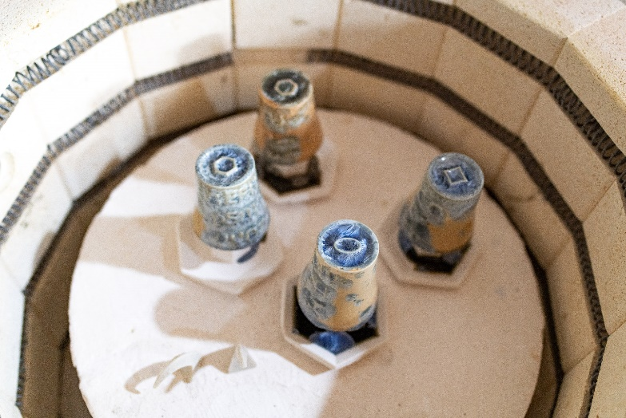
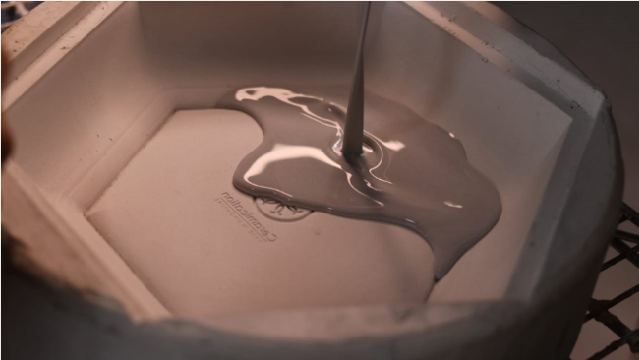
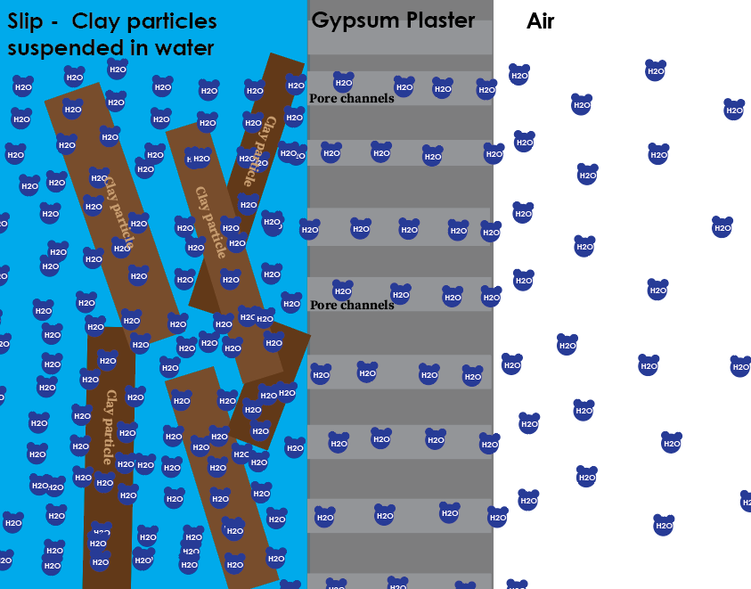
Our Forming Technique Slipcasting
Rayn’s quest to perfect his glazes entailed innumerable tests. Needing to create a multitude of test pieces quickly and efficiently, he turned to slipcasting as his forming technique.
What began as a practical need transformed into a means of fulfilling his artistic vision. As a potter who started on the wheel, Rayn is able to break from making round forms using the slipcasting technique.
When slip is poured into a mould made of gypsum plaster, water molecules in the clay body start to move past other components and into the pores of the gypsum plaster via capillary action. The other solid components, however, are too big to enter the pores and are deposited at the surface of the mould. A clay skin layer gradually builds up, conforming to the inner shape and contours of the mould. The longer the slip is held in the mould, the thicker the ware.

Slide 9
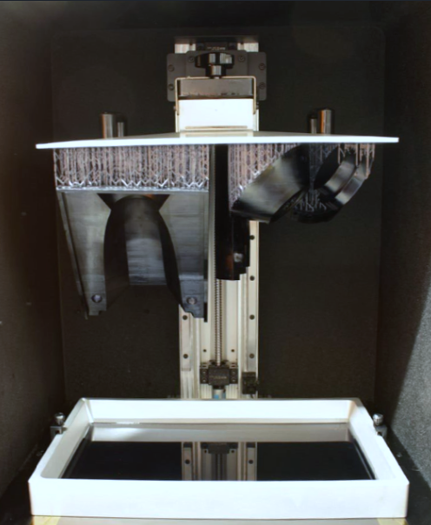
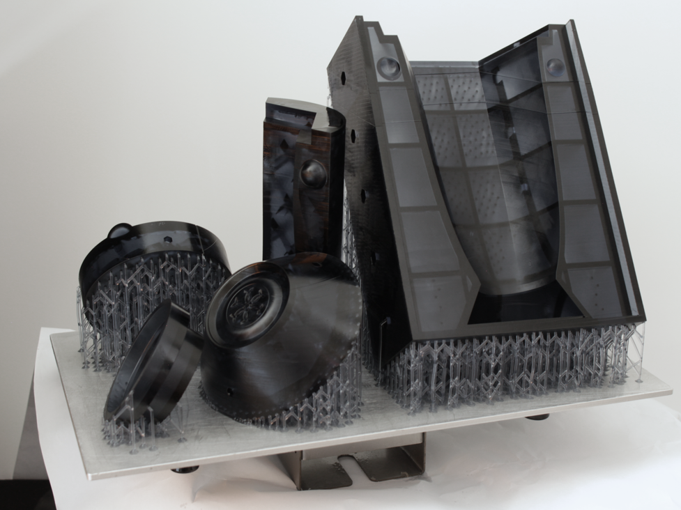
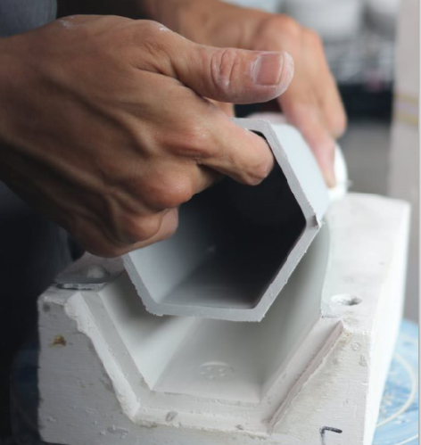
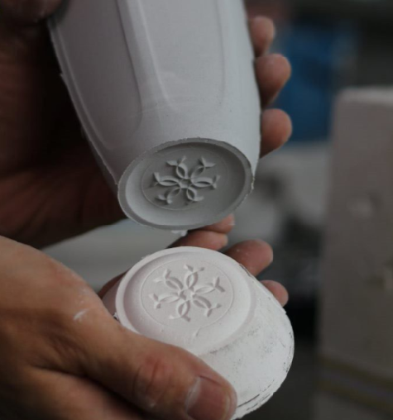
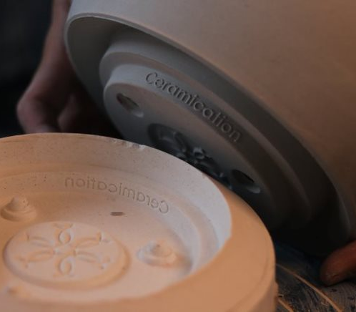
The Intersection of Technology and Art
Augmenting mould design and mould making using CAD and 3D printing technology.
‘Utilise technology to unlock human potential’

Slide 10
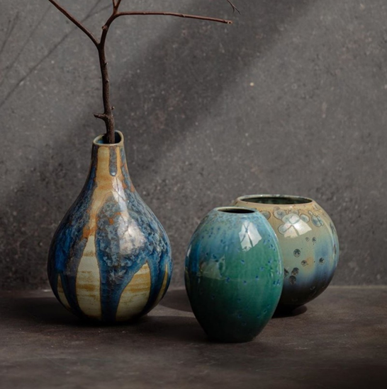
It was
Love at first sight
for Rayn when he laid eyes on a pottery piece finished with macro-crystalline glaze. Intrigued, he embarked on a four-year-long journey to experiment and perfect his current repertoire of glazes. Each glaze formulation is first saturated with metallic oxides before a smidgen of crystal nucleation agent is added. By controlling the heat work received by the glaze, the population and growth rate of the crystal blooms can be influenced. But the location and germination of each individual nuclei are random, and so no two pieces are ever alike.
Wheel-thrown works with macro-crystalline glaze

Slide 11
Macro-Crystalline Glaze
‘What nature gave, humans must nurture’
Many beautiful things in the world are survivors of the toughest, most inhospitable conditions. The formulation of macro-crystals in glazes is analogous to the natural creation of willemite crystals in the earth’s magma. The million-years-long process is whittled down to just twenty-four hours in a modern-day kiln. With the application of immense heat and precise control, spectacular flower-like crystals bloom all over the surface.

Slide 12
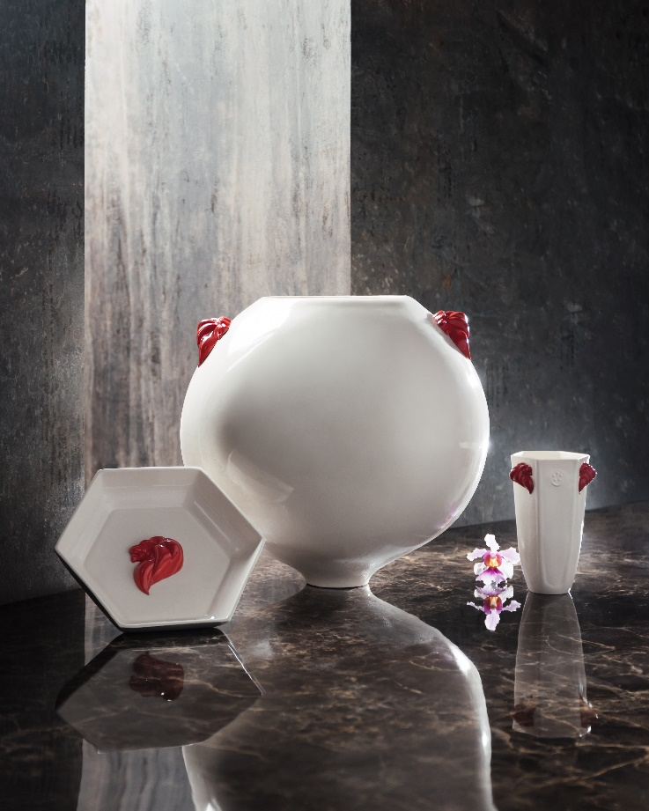
Our Signature The Dignitary Series
Singapore is synonymous with innovation and visionary thinking. Inspired by this psyche, for her 55th birthday, Ceramication created a collection of limited-edition porcelain pieces, each bearing the iconic lion city symbol. The symbol was created by Mr Michael Lee in 1986 as a gift to the nation. It can be used by any individual or organisation that identifies with the three national values: Courage, Excellence and Strength. Behold the raised 3D levelling, a feat that signifies the artist’s conviction to never settle for what is easy.
9 August is also a day of special significance for Ceramication, as the company shares the same birthday as Singapore.
‘Produce designs that pay homage to the past’
Photographs of the dignitary series by Jayden Tan at Headquators studio.

Slide 13
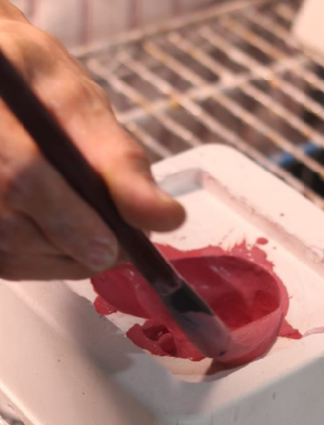
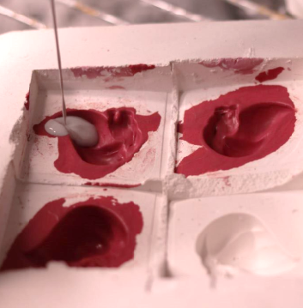
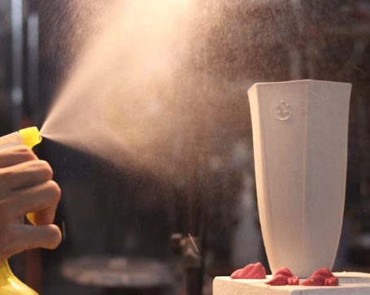
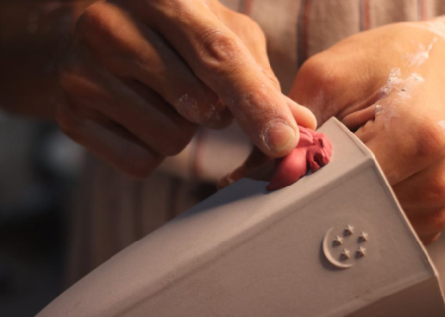

Slide 14
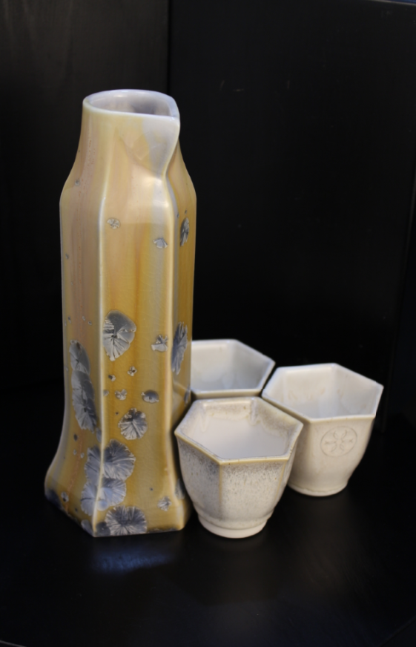
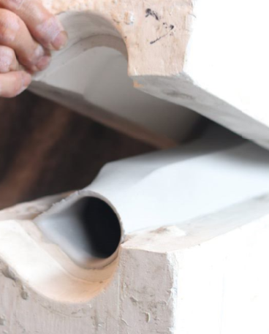
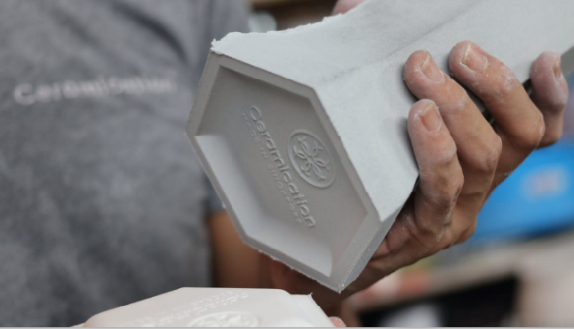
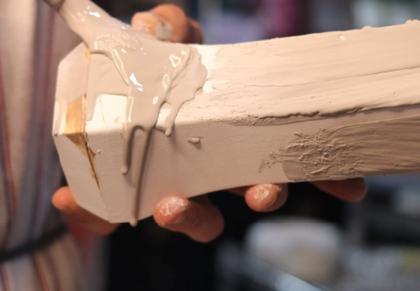
Our signature
Table Vase & Teacup Set
in Macro-crystalline glaze
Celebrating the bond of friendship, this set of tableware represents how single pieces, each with different functions, come together to serve a greater purpose.

Slide 15
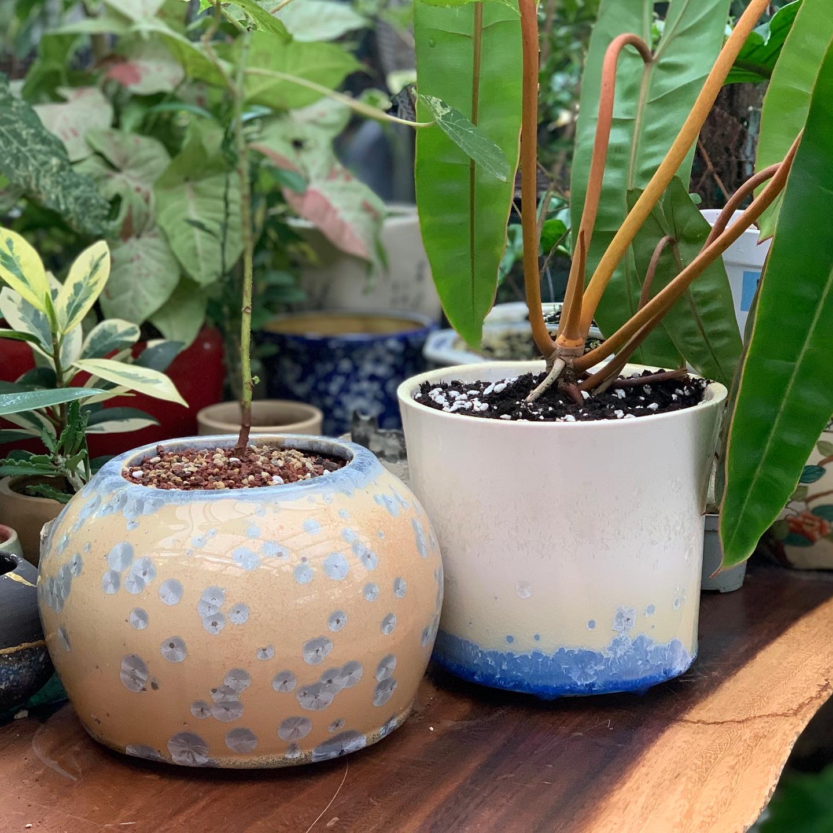
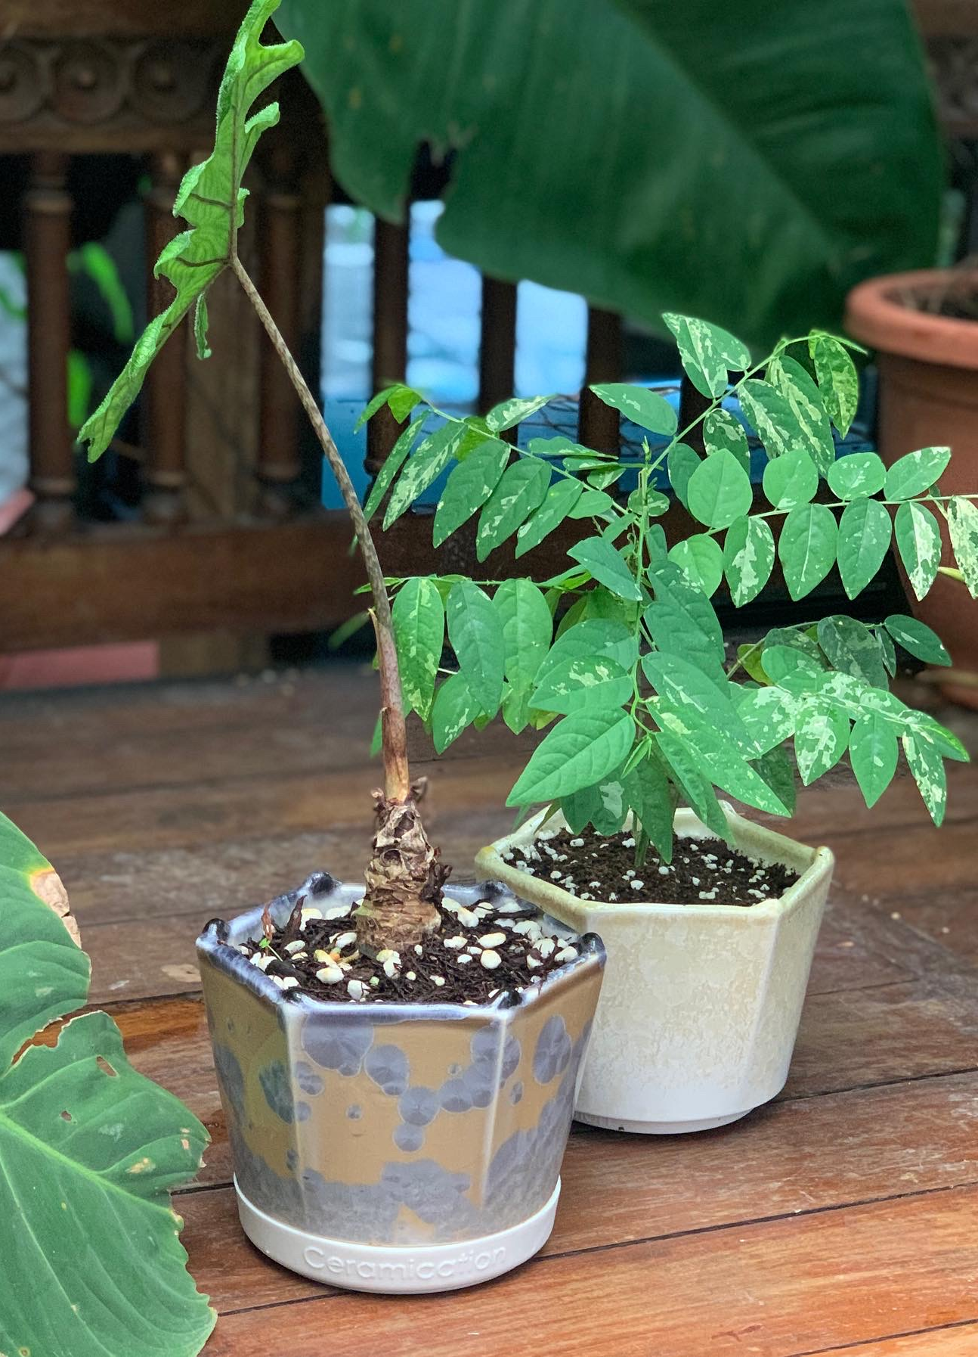
Hosted and coordinated by Littlebotany, a fundraiser for Assisi Hospice was held in March 2022 to help drive funding for palliative care. Ceramication sponsored a series of sky-themed handcrafted pots. The event managed to raise eight thousand dollars for the cause through an Instagram Live auction.

Slide 16
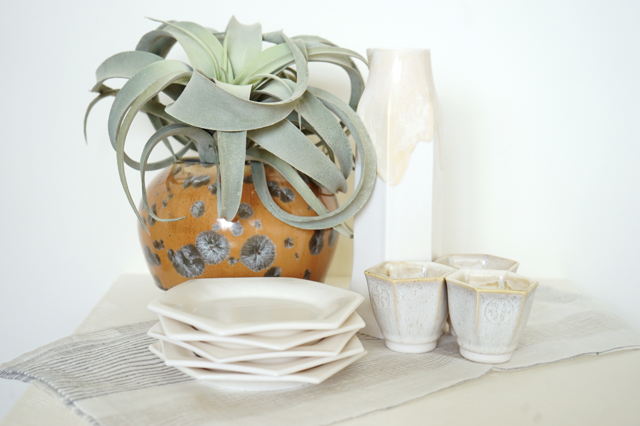
CRATEANDBARREL (Fall 2021)

Slide 17
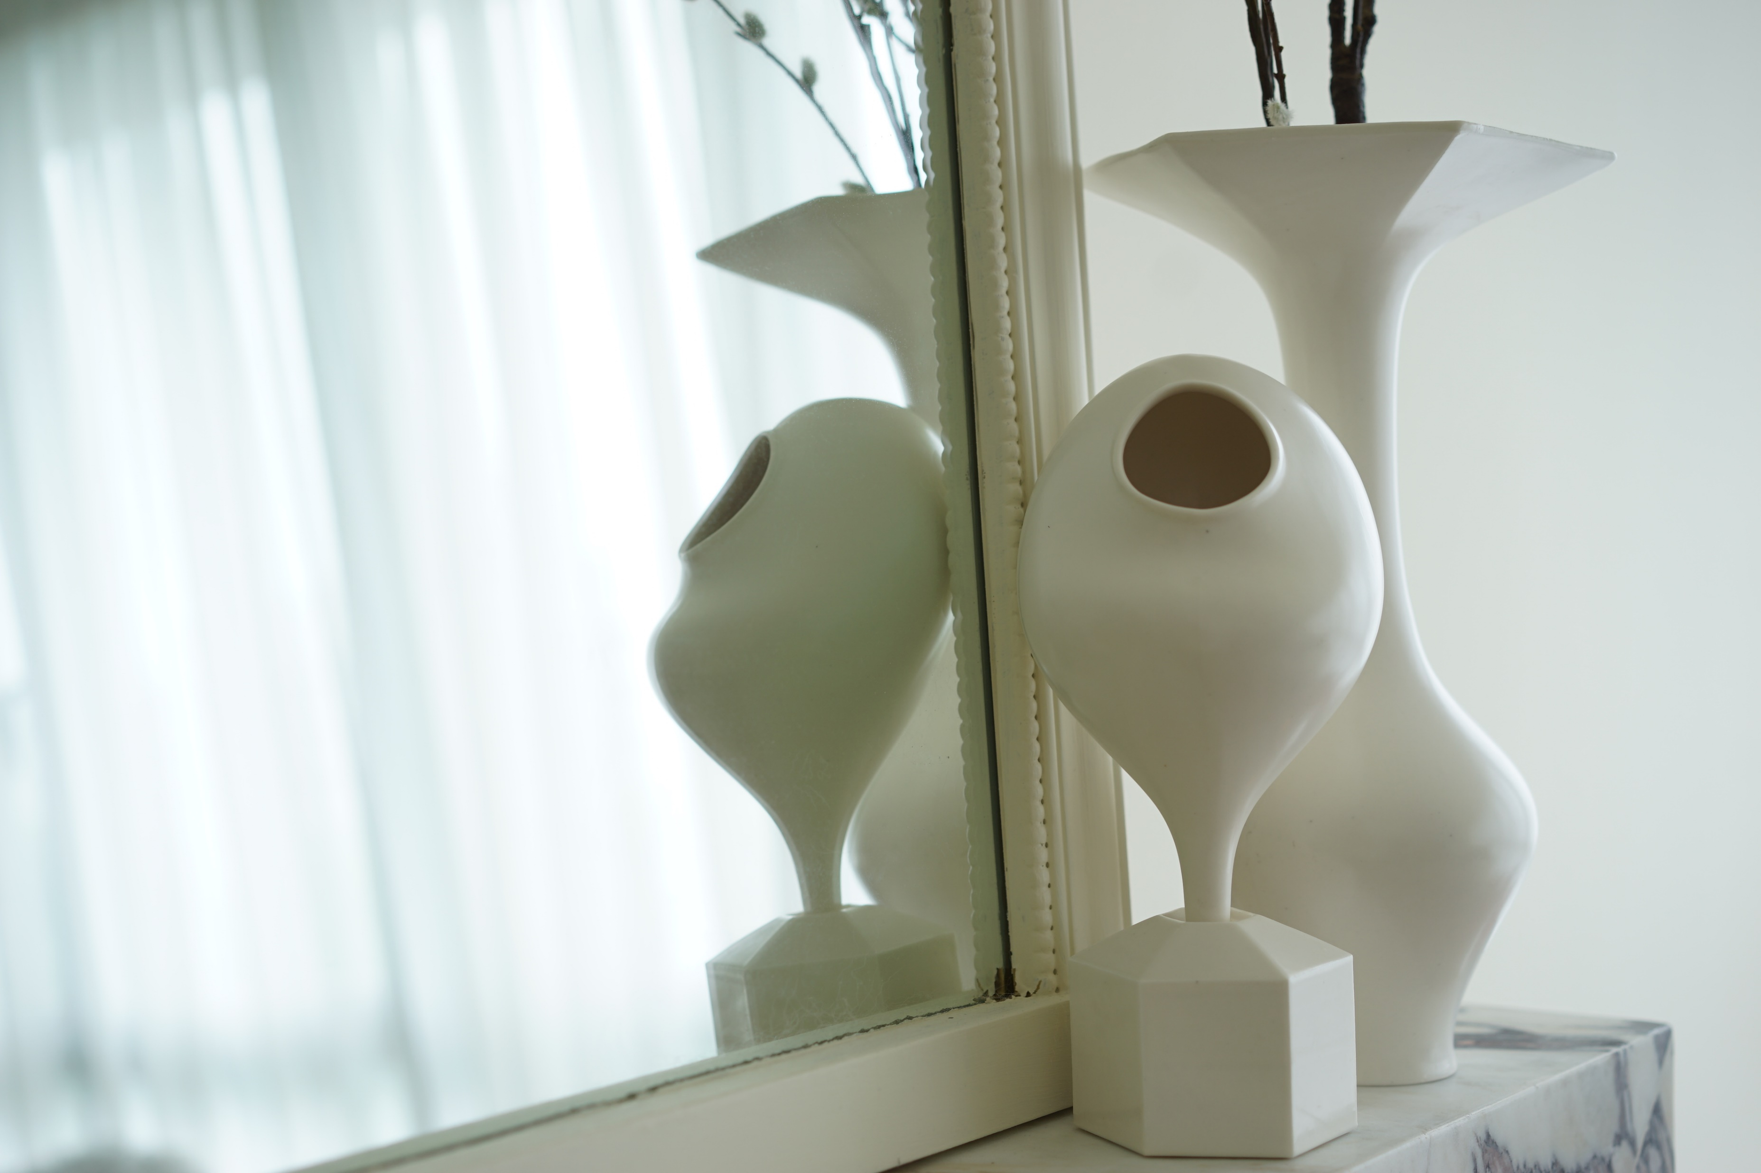
Crate and Barrel (Fall 2021). Themed “Asian serving story”, the collection was created circa the festive season to allow customers to bring home unique, locally crafted artware.

Slide 18
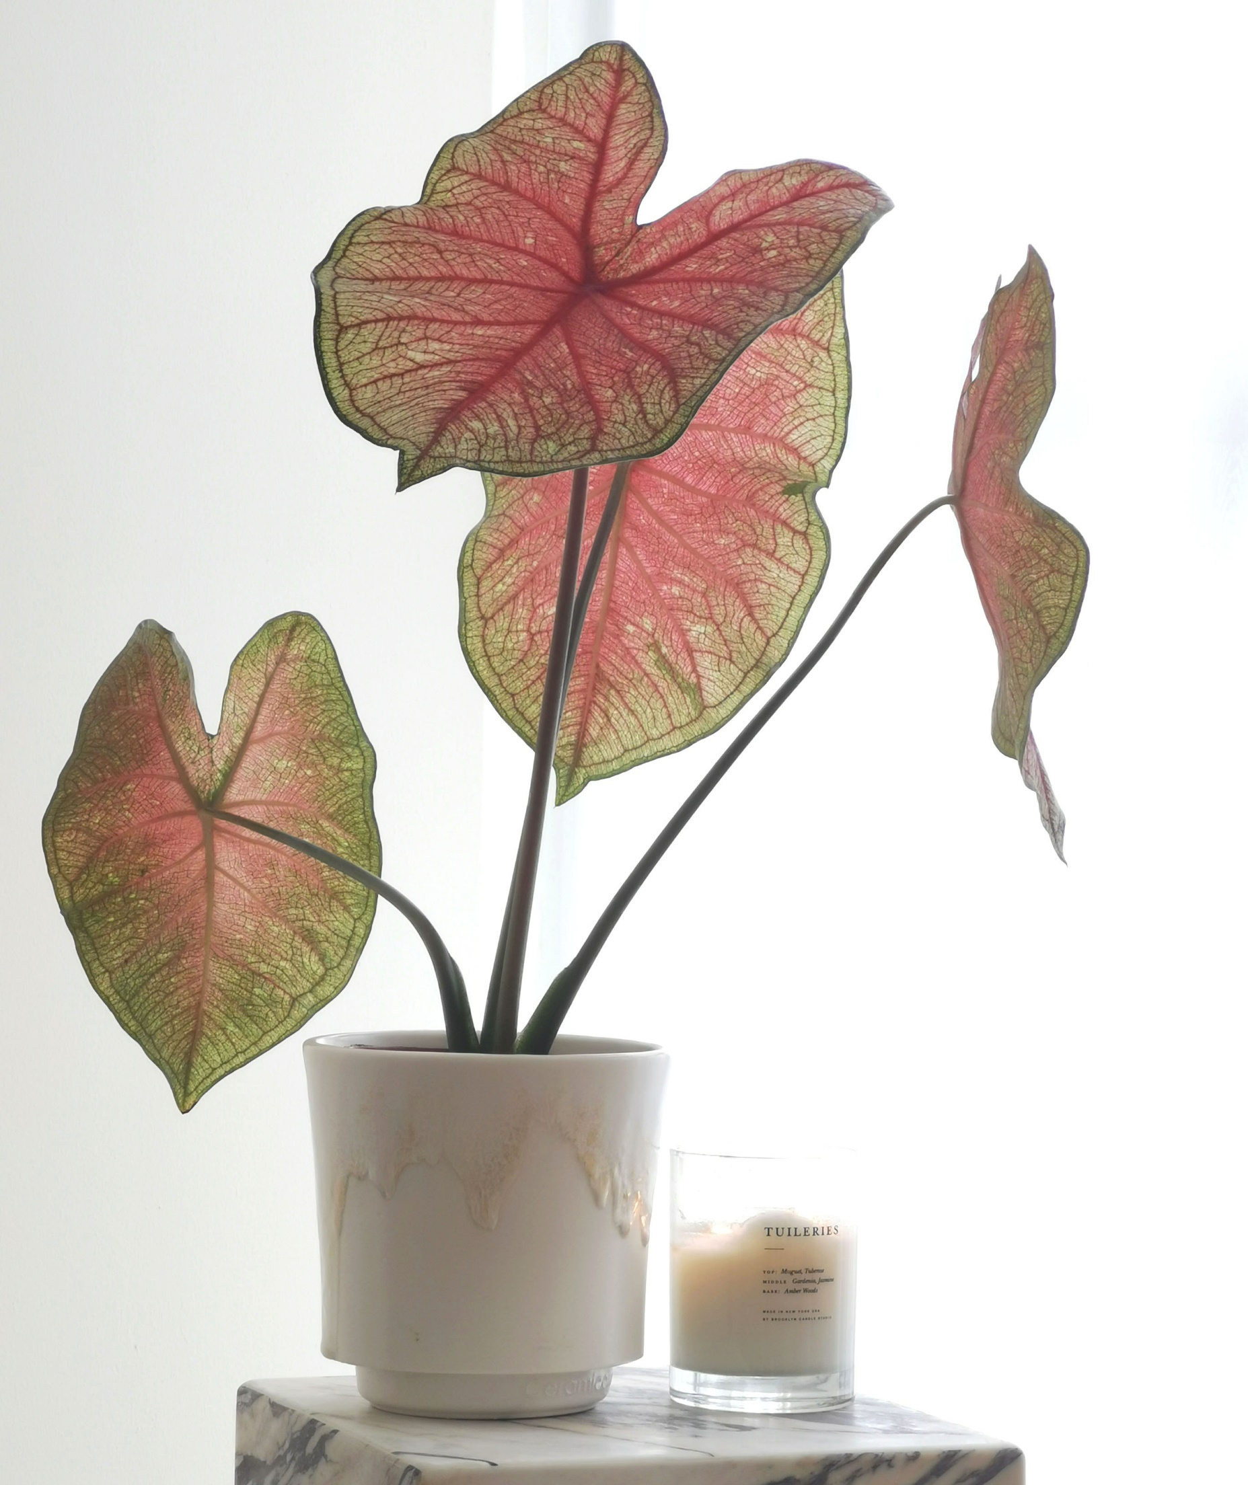
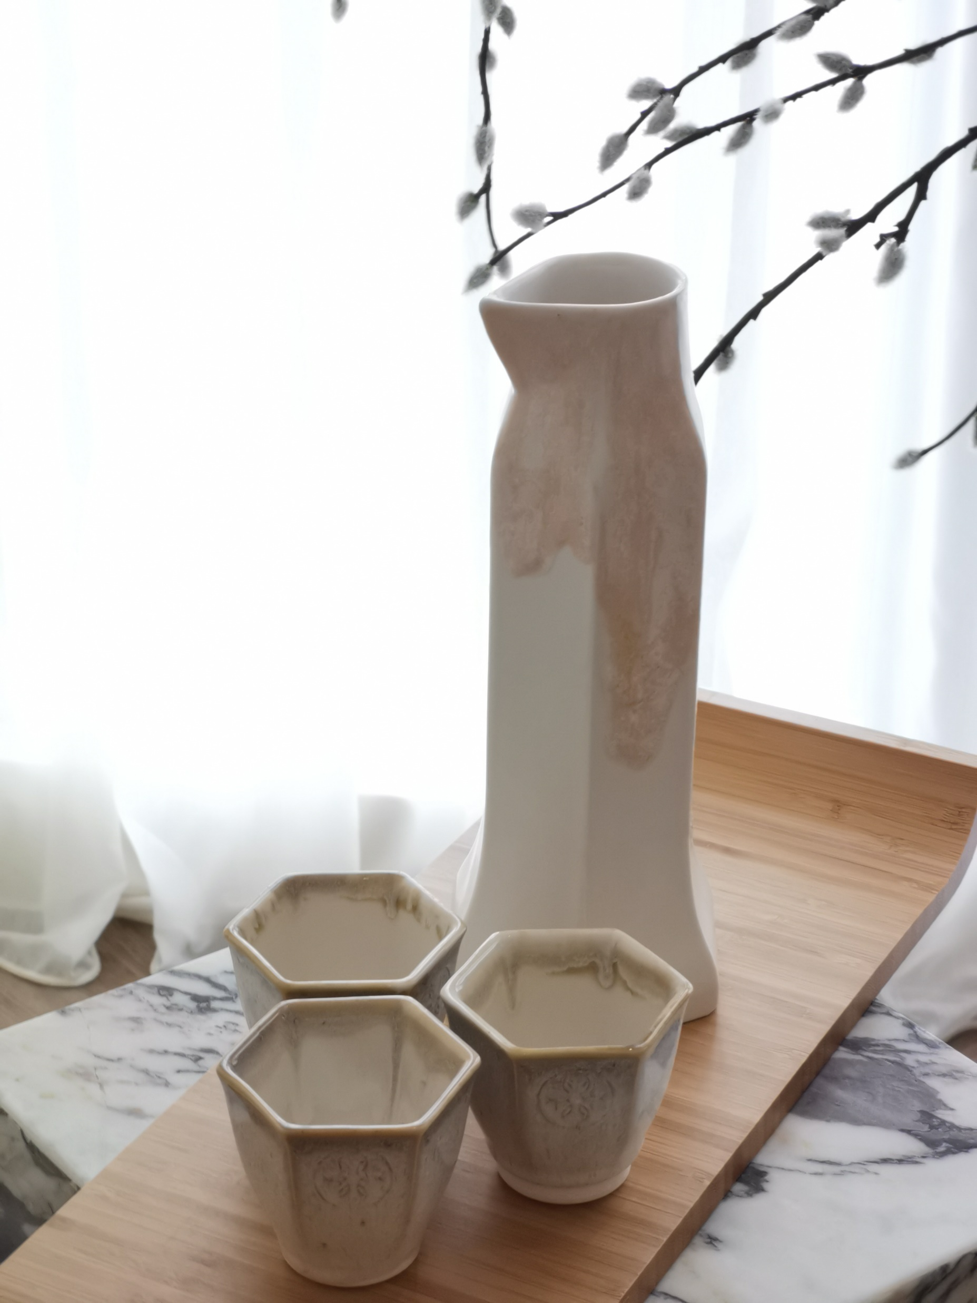
Rayn was given the freedom to execute his artistic vision in this collection. Collaborating with the Crate and Barrel team, he curated a final line-up, featuring an on-trend colour palette.

Slide 19
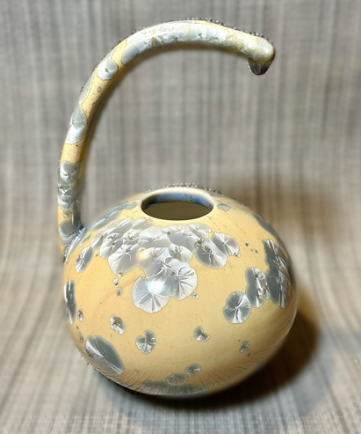
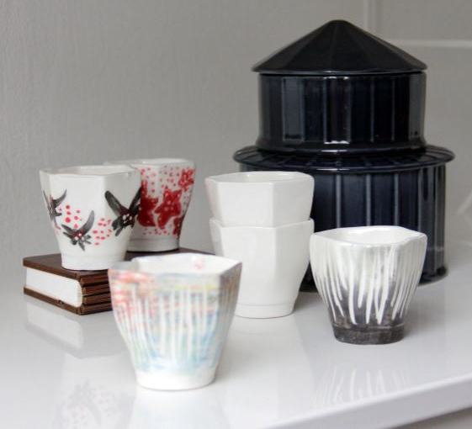
Our Products and Services
Bespoke, handcrafted commissioned pieces for individual collectors
Themed, artisanal collections for retail chains and F&B concepts
Hands-on activities for corporate team building
A collaboration between Singapore artisanal perfume label Scent by SIX and Ceramication
Slipcasting workshop at The General Co.

